Slide 1
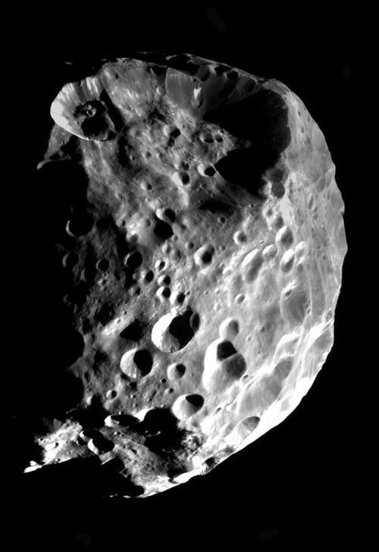
Predictions of Stellar Occultations by Irregular Satellites up to 2020
Altair Ramos Gomes-Júnior^{1,3}
M. Assafin¹
L. Beauvalet^{2,3}
J. Desmars³
R. Vieira-Martins^{1,2,4}
J. I. B Camargo^{2,4}
B. E. Morgado^{1,2}
F. Braga-Ribas⁵
(1) Observatório do Valongo
(2) Observatório Nacional
(3) Observatoire de Paris/IMCCE
(4) Laboratório interinstitucional de e-Astronomia
(5) Universidade Tecnológica Federal do Paraná
Phoebe
Source: Cassini
IAU Symposium 330 – April 26, 2017
Notes:
26/04/17
<número>
<número>

Slide 2
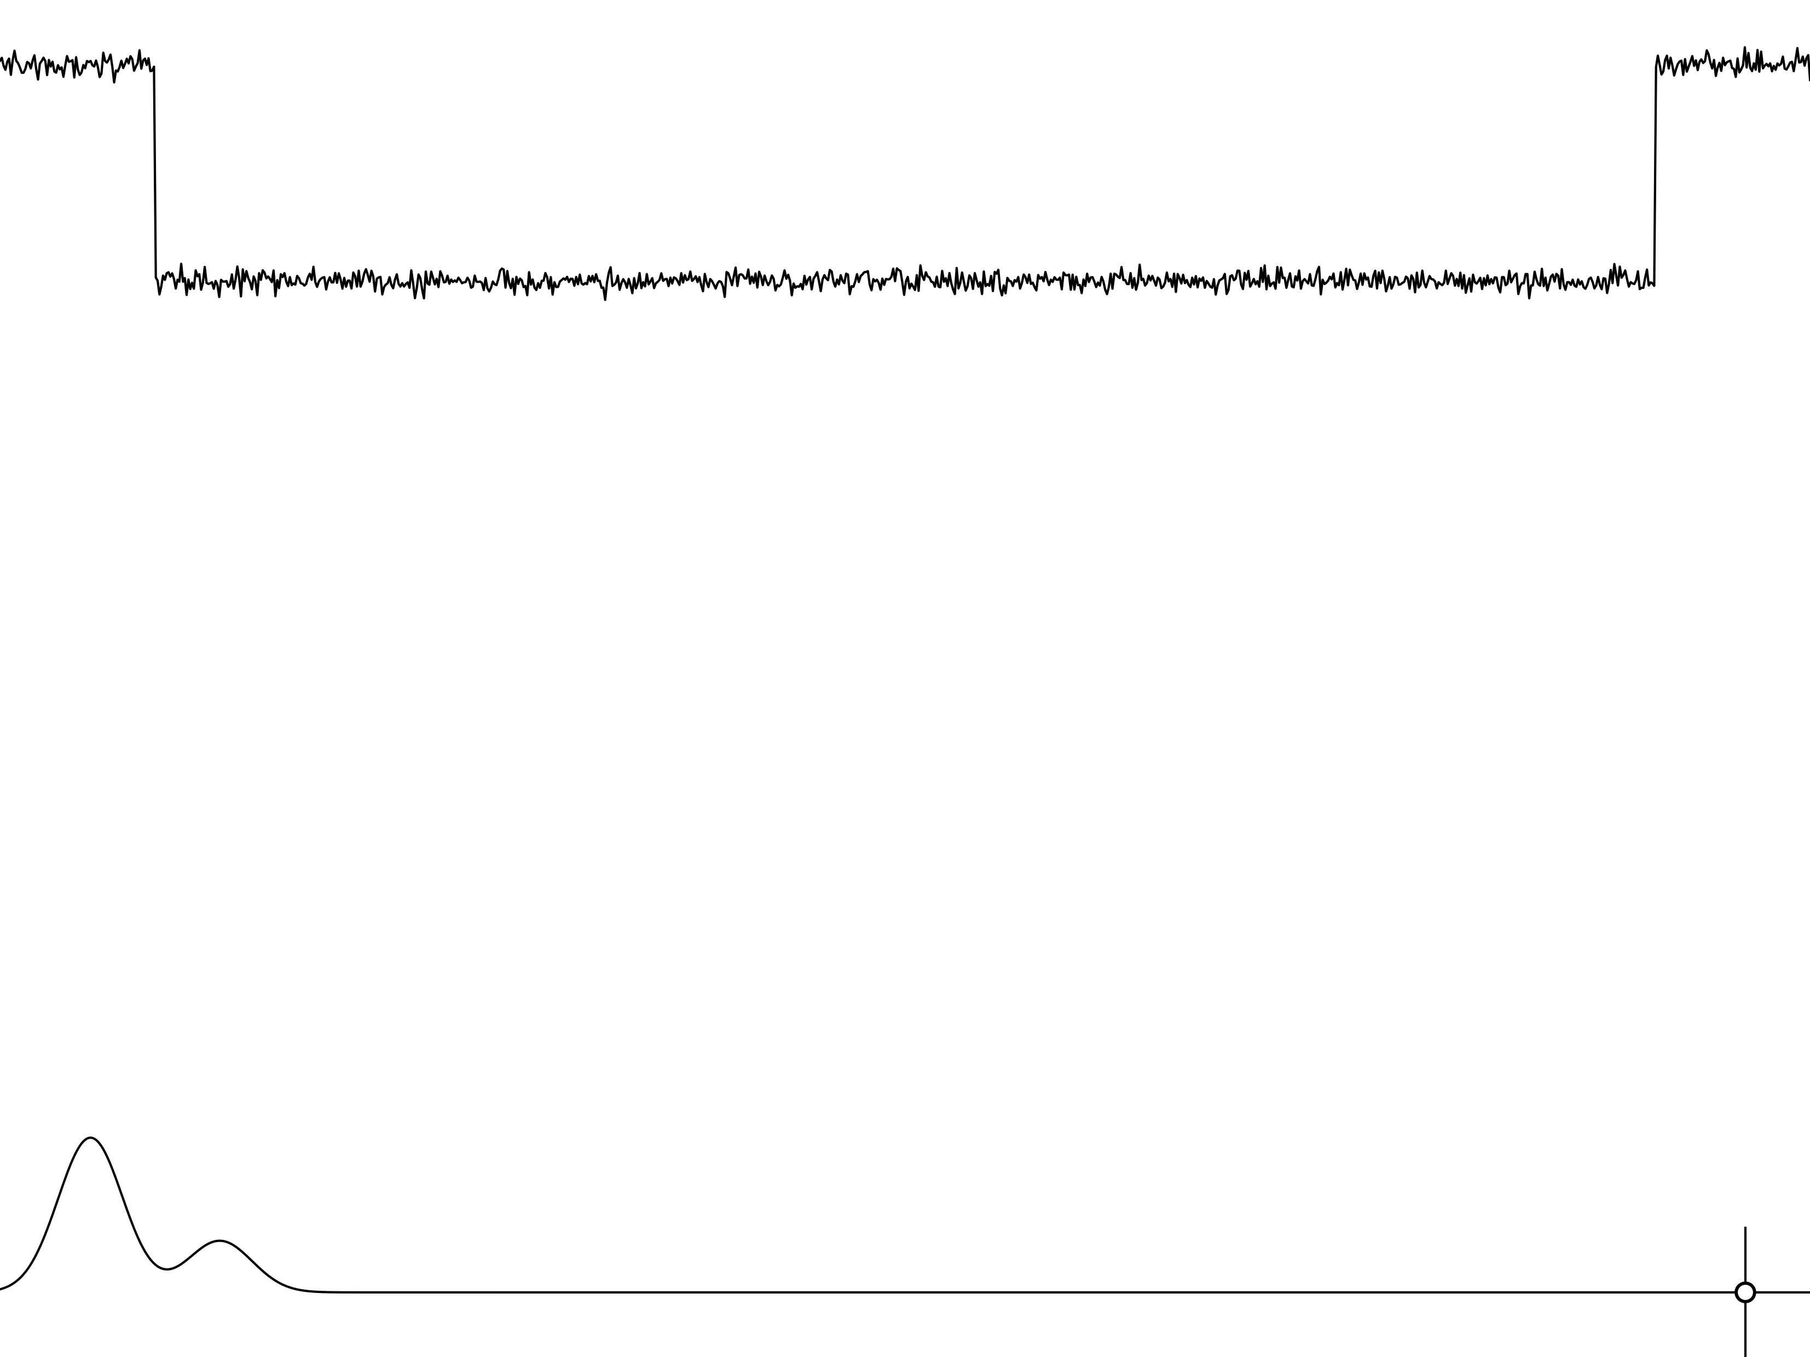
Irregular Satellites
Burns (1986): Satellites are irregular when their orbital planes precess primarily under the influence of torques from the Sun.
Their orbits are eccentric, usually highly inclined and distant from their planets. The direction of their movements can be prograde or retrograde.
IAU Symposium 330 – April 26, 2017
Notes:
26/04/17
<número>
<número>

Slide 3
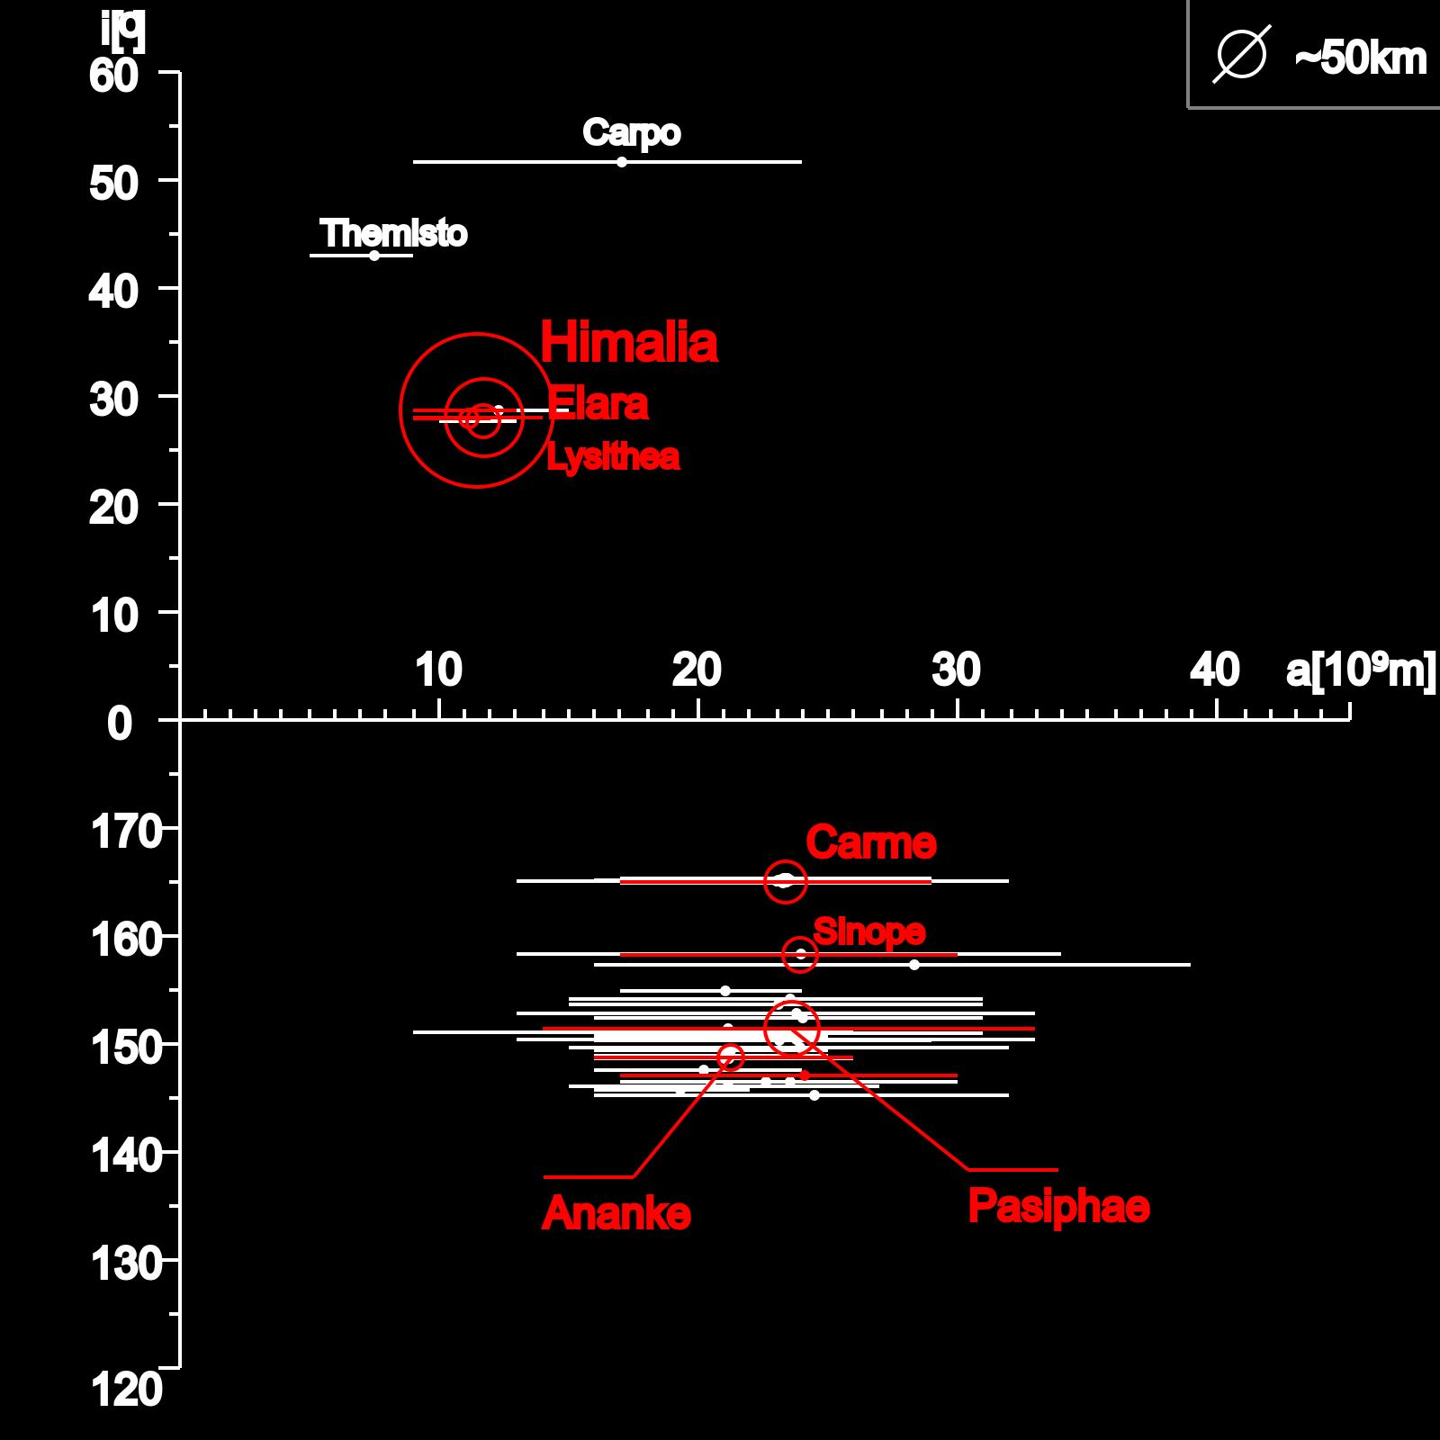
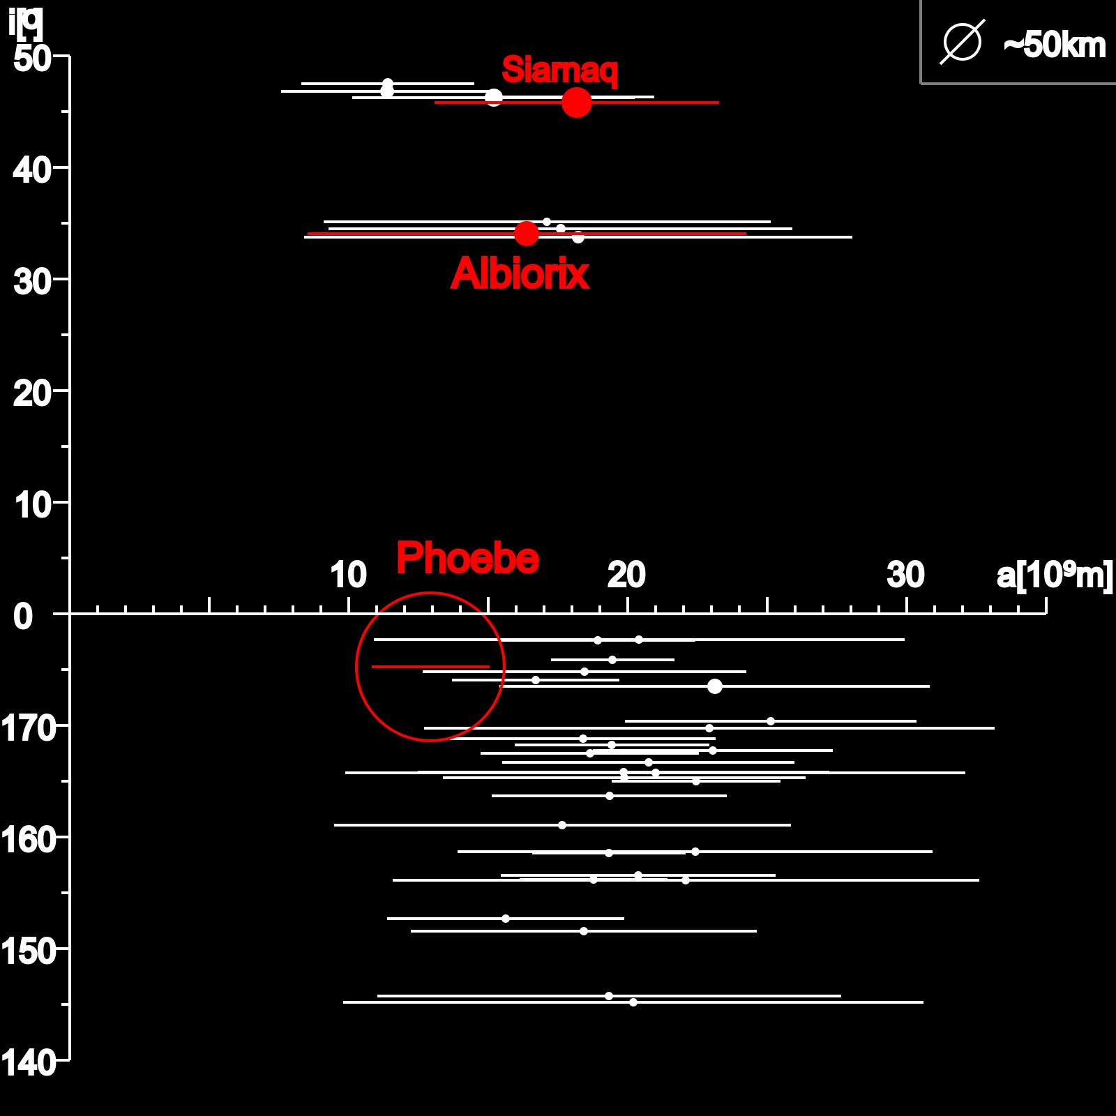
Irregular Satellites
Satellites of Jupiter
Satellites of Saturn
IAU Symposium 330 – April 26, 2017
Notes:
26/04/17
<número>
<número>

Slide 4
Irregular Satellites
Capture:
Gas Drag (Cuk & Burns, 2003);
3-body interation (Nesvorný et al., 2007);
Collision (Sheppard, 2006).
Orbital Evolution:
Origin of the orbital family of satellites (Nesvorný et al., 2004);
IAU Symposium 330 – April 26, 2017
Notes:
26/04/17
<número>
<número>

Slide 5
Goal
Predict stellar occultation by irregular satellites to determine:
Size;
Shape;
Albedo;
Density, if mass known;
Characterize family of satellites.
IAU Symposium 330 – April 26, 2017
Notes:
26/04/17
<número>
<número>

Slide 6
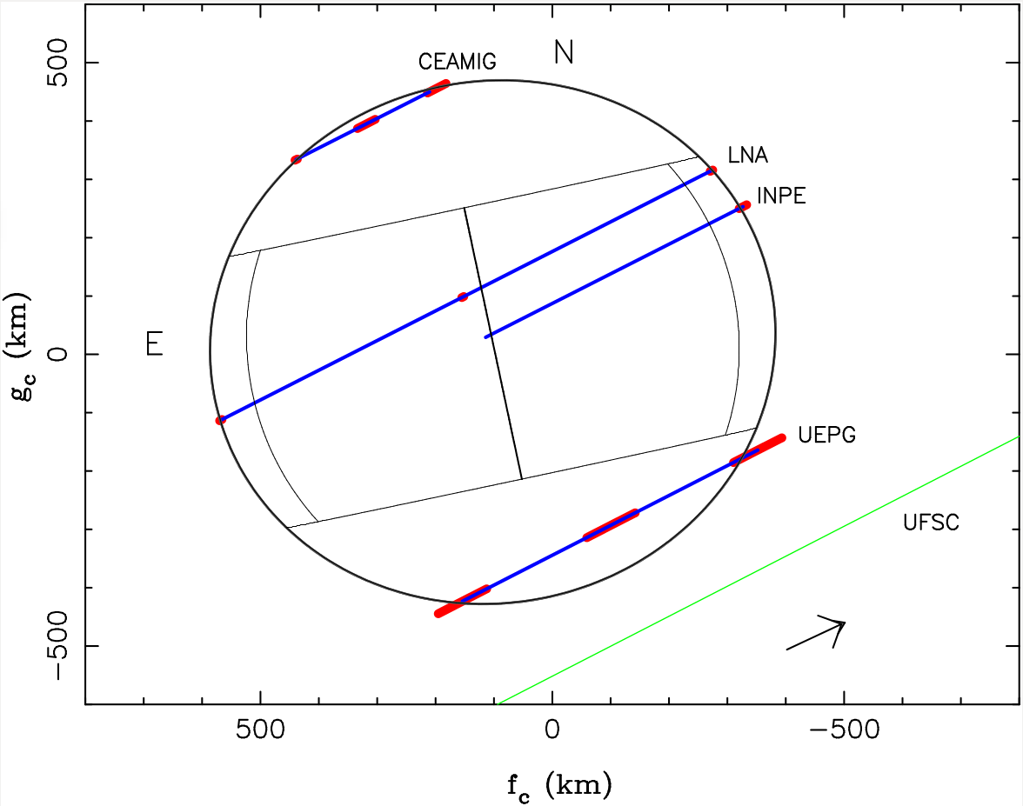
Example: Ceres (2010)
Gomes-Júnior et al. (2015, MNRAS)

Slide 7
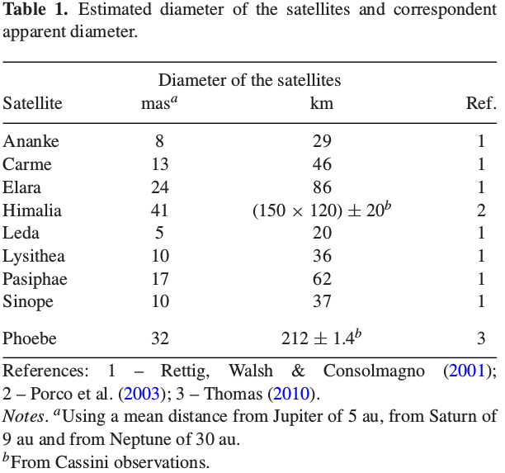
Irregular Satellites
Gomes-Júnior et al. (2016)
IAU Symposium 330 – April 26, 2017
Notes:
26/04/17
<número>
<número>

Slide 8
Opportunity for Irregular Satellites
Successful experience in stellar occultations by TNOs/Centaurs in an international collaboration;
Saturn and Jupiter will cross the central side of the Galactic Plane in 2018 and 2019-2020, respectivelly;
Gaia;
Improvement of ephemeris using our positions (Gomes-Júnior, 2015).
IAU Symposium 330 – April 26, 2017
Notes:
26/04/17
<número>
<número>

Slide 9
Ephemeris
Phoebe:
Update the ephemeris of Desmars et al. (2013) with +75% in the number of observations.
Jupiter Satellites:
Special Tailored Ephemeris;
Ephemeris for the 8 major irregular satellites of Jupiter;
Only using the positions of Gomes-Júnior et al. (2015, A&A)
JUP340 (Brozovic & Jacobson, 2017)
IAU Symposium 330 – April 26, 2017
Notes:
26/04/17
<número>
<número>

Slide 10
Gaia
Stars brighter than G=16.5;
Proper Motion from TGAS;
Number of occultations: 6230 from January 1st, 2017 up to December 31, 2020;
10% with stars brighter than R=14. Potentially observable by amateurs.
25% with stars brighter than R=15.
IAU Symposium 330 – April 26, 2017
Notes:
26/04/17
<número>
<número>

Slide 11
Occultations
Satellite | 2017 | 2018 | 2019 | 2020 | Total
Ananke | 16 | 44 | 359 | 187 | 606
Carme | 16 | 33 | 369 | 235 | 653
Elara | 17 | 39 | 305 | 193 | 554
Himalia | 13 | 55 | 380 | 222 | 670
Leda | 24 | 51 | 536 | 207 | 818
Lysithea | 10 | 35 | 414 | 221 | 680
Pasiphae | 20 | 44 | 522 | 226 | 812
Sinope | 21 | 45 | 491 | 279 | 836
Phoebe | 234 | 274 | 78 | 15 | 601
IAU Symposium 330 – April 26, 2017

Slide 12
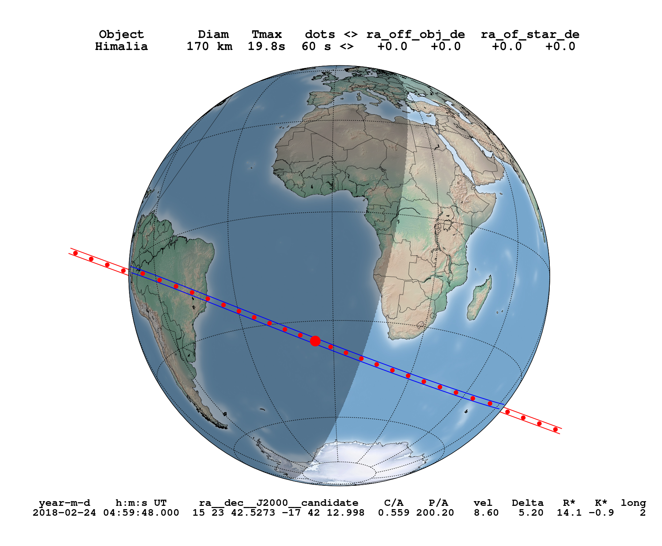
Himalia – February 24, 2018
IAU Symposium 330 – April 26, 2017

Slide 13
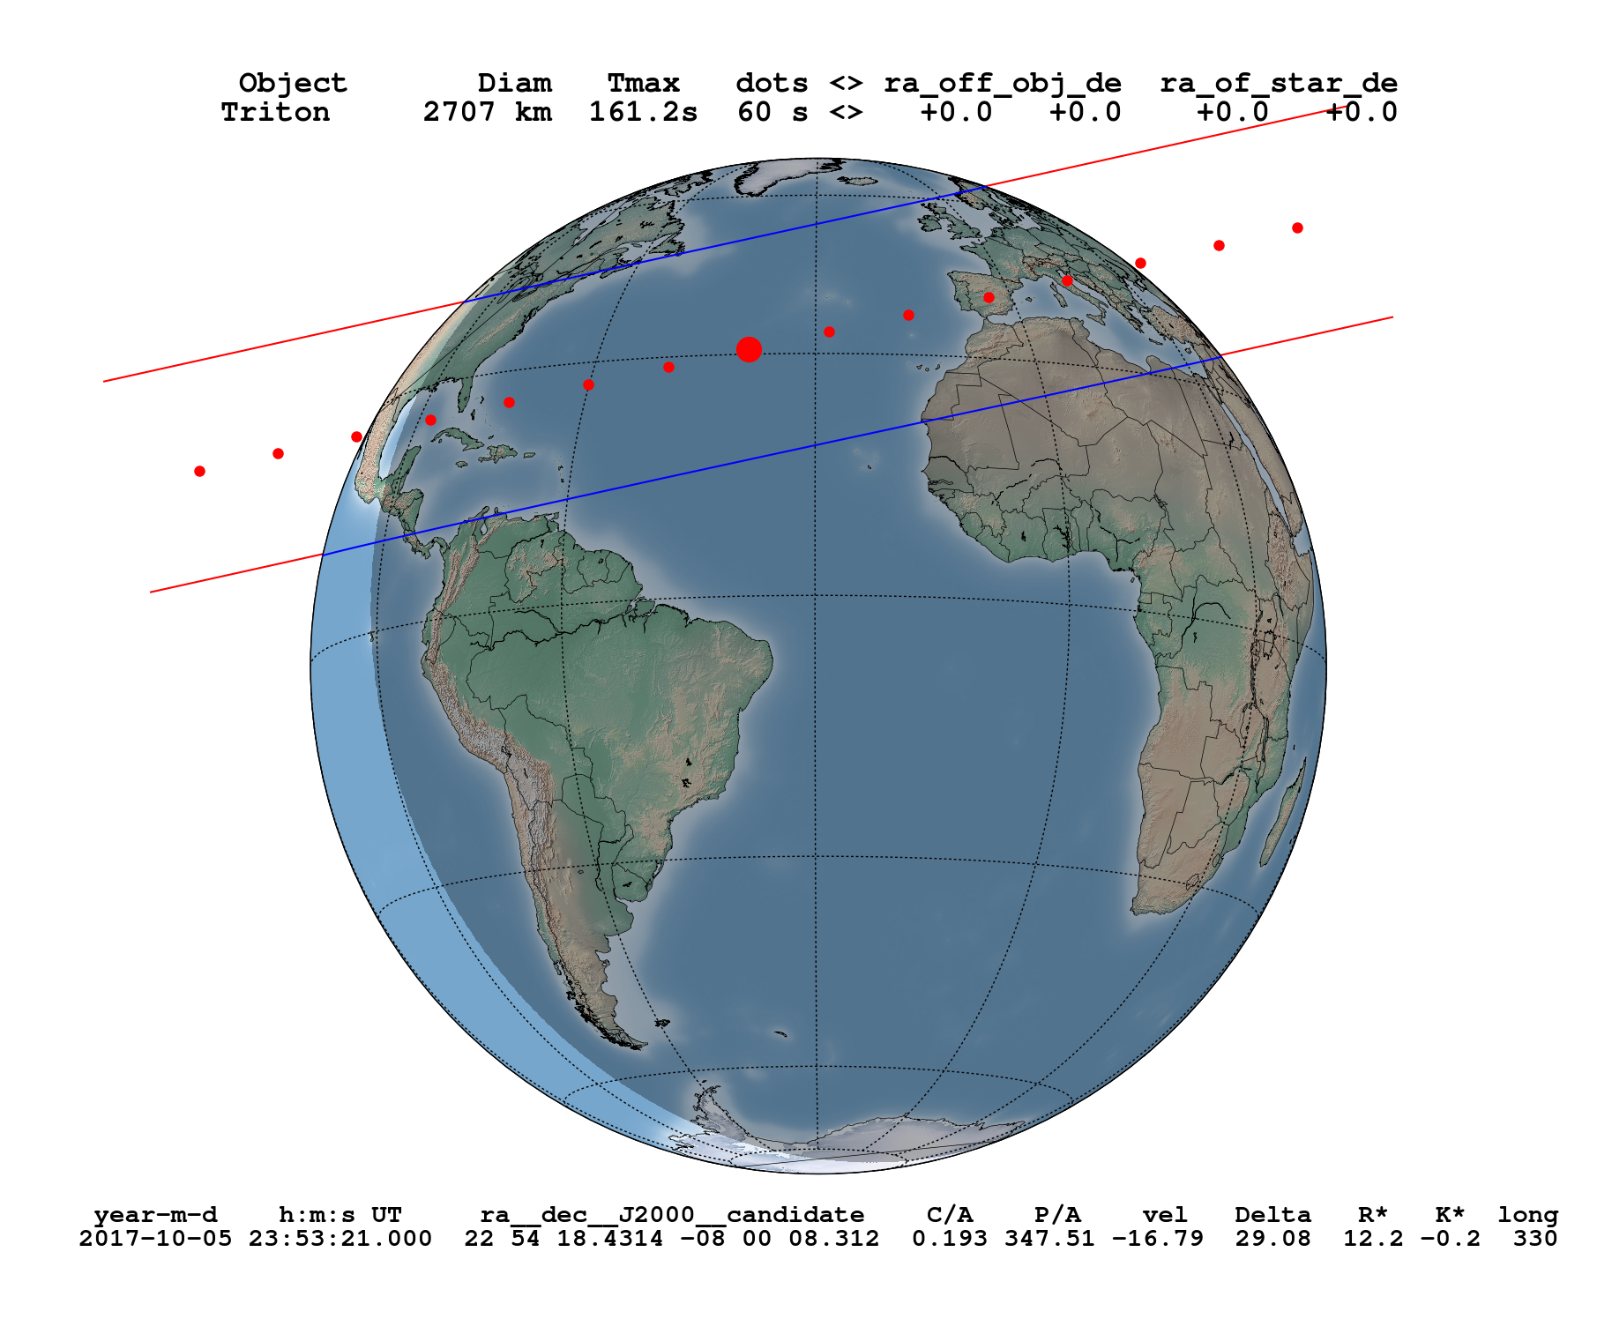
Triton – October 10, 2017
IAU Symposium 330 – April 26, 2017

Slide 14
Next Steps
Re-reduce the observations with GAIA catalogue;
Numerical Integration of the orbits of the Irregular Satellites using all positions available;
Update occultation predictions using Gaia DR2;
Observe stellar occultations by these objects.
IAU Symposium 330 – April 26, 2017
Notes:
26/04/17
<número>
<número>

Slide 15
Thank You
IAU Symposium 330 – April 26, 2017
Notes:
26/04/17
<número>
<número>

